Slide 1
CANDEV ISED_2170
Abdul Jabbar, Siraj, Mansour, Adil

Slide 2
Our Solution
Tool to evaluate how social media impacts the contact center and media relations at ISED
Provides a dashboard
Input: start and end date for social media campaign
Output: visualizations of how contact center and media relations statistics are affected by campaign

Slide 3
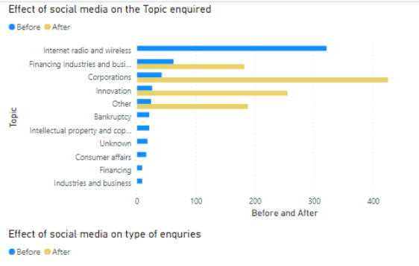
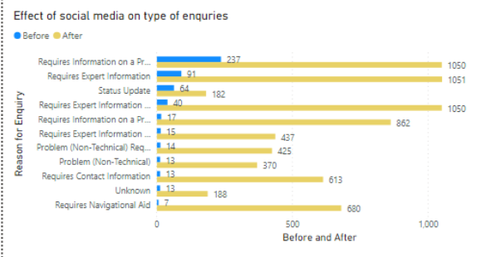
Demo
Input, start-date = 2019-01-24
end-date = 2019-02-24
Output: visualizations from PowerBi

Slide 4
How did we establish the relationship between social media and contact center/media relations?
Introduced a new variable called ‘topic’ into the datasets of social media and then established a relationship between social media and contact center/media relations datasets
The ‘topic’ variable consists of topics like, bankruptcy, innovation, science, internet/wireless/radio, etc. these are some of the categories that contact center/media relations enquiries fall into AND this variable could also be used to categorize the tweets of social media posts

Slide 5
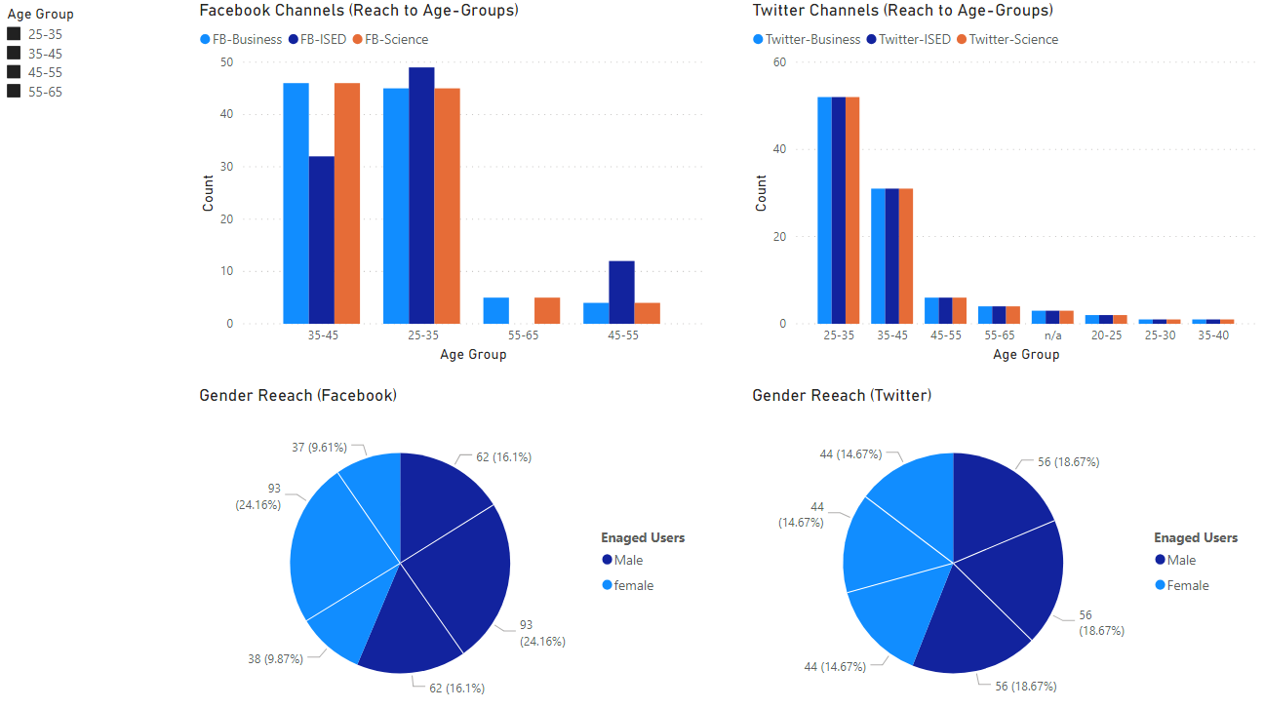
Measuring outreach to gender/age-groups

